Slide 1

Orchestrate Web of Things by Node-RED and Node Generator
Kunihiko Toumura
Research and Development Group
Hitachi, Ltd.

Slide 2
1. Web of Things and Thing Description
WoT Thing Description describes each IoT Platform and Things,
and Applications use the TD as an open specification of each PF or Things.
Cross-platform
IoT Application
WoT Thing Description
General Metadata
Interaction Affordances
Data Schemas
Public Security Configuration
IoT
Platform A
IoT
Platform B
IoT
Platform C
IoT
Platform D
Protocol Binding(s)

Slide 3
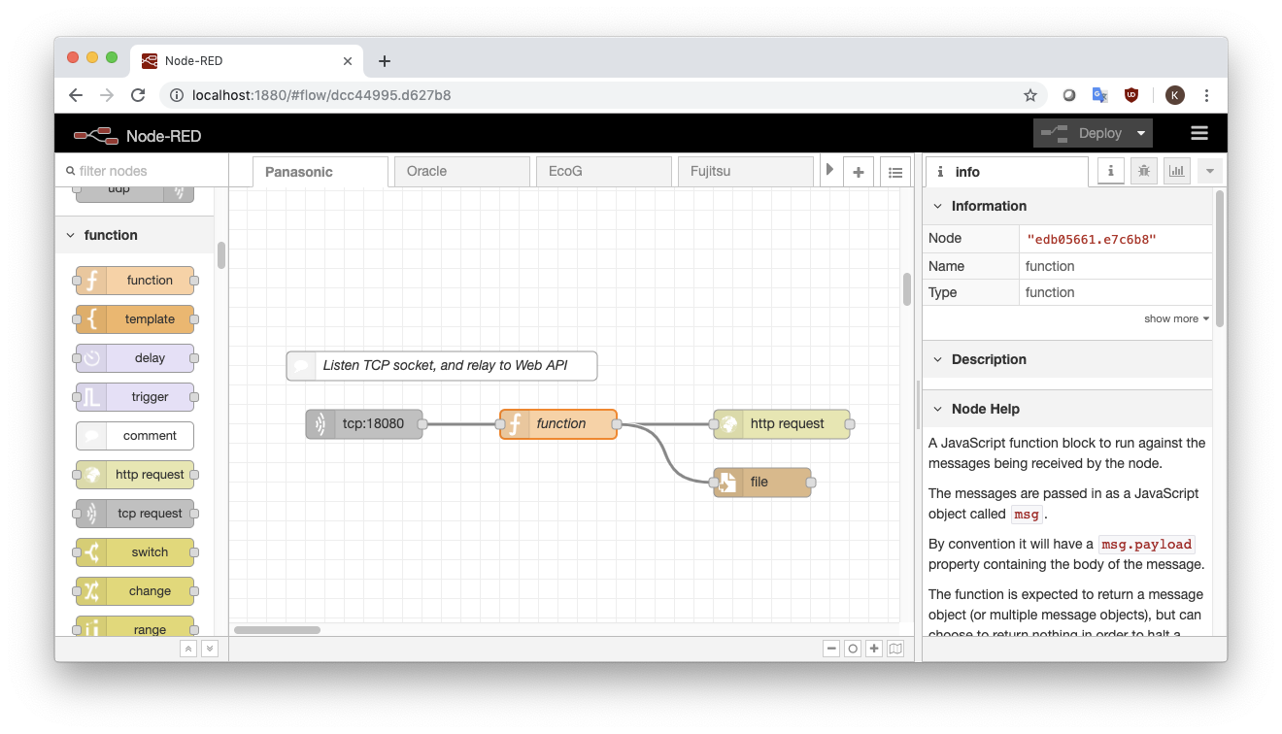
2. Node-RED: the Well-known Low-code Development Tool
Node-RED is widely used in IoT application development field,
because of its intuitive programming user interface.
Node-RED is a flow-based programming environment for IoT application.
Developing application is simple: place and connect the “nodes”.

Slide 4
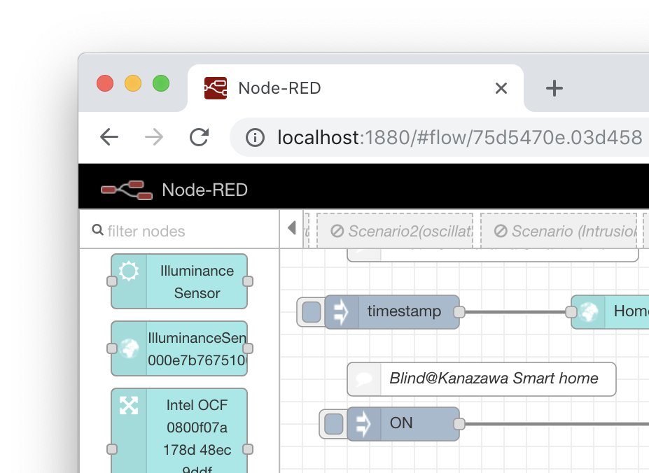
3. Combine Node-RED with the Web of Things
“Node Generator” simplifies IoT application development
by generating Node module of Node-RED from a Thing Description
By generating a Node, developer can handle a Node as an avatar of a Thing.
To write a property of the Thing, send message and its payload will be written.
To read a property, send a message as a trigger, and then the Node emit a message which contains a value of the property.
WoT Thing Description
Node
Generator
General Metadata
Interaction Affordances
Data Schemas
Public Security Configuration
Protocol Binding(s)

Slide 5
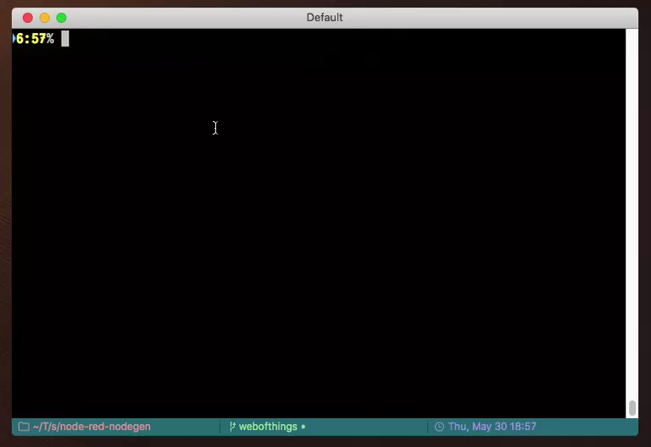
4. How to Use: Generate and Install a Node Module
0. Install Node Generator
% npm install –g node-red-nodegen
1. Generate a Node module
% node-red-nodegen td.jsonld
2. Install to Node-RED
% cd ~/.node-red
% npm install
generated-module-dir
3. Run Node-RED
% node-red

Slide 6
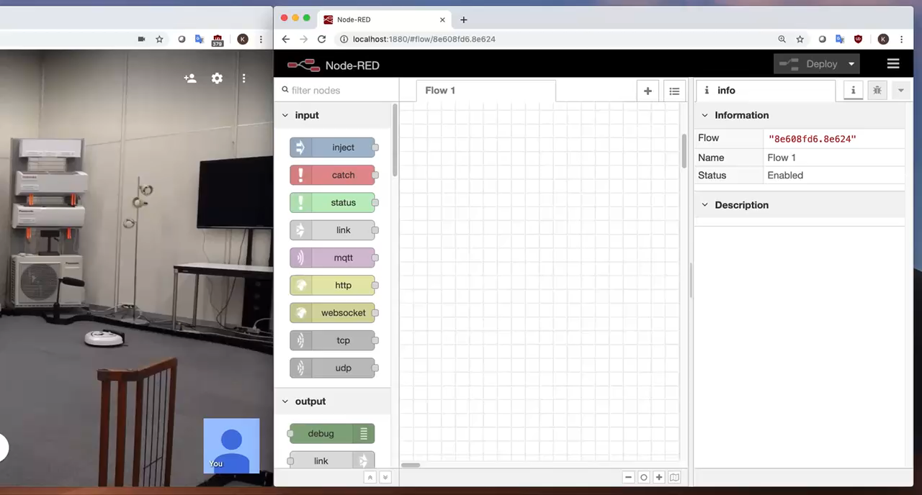
5. How to Use: Write a Simple Application

Slide 7
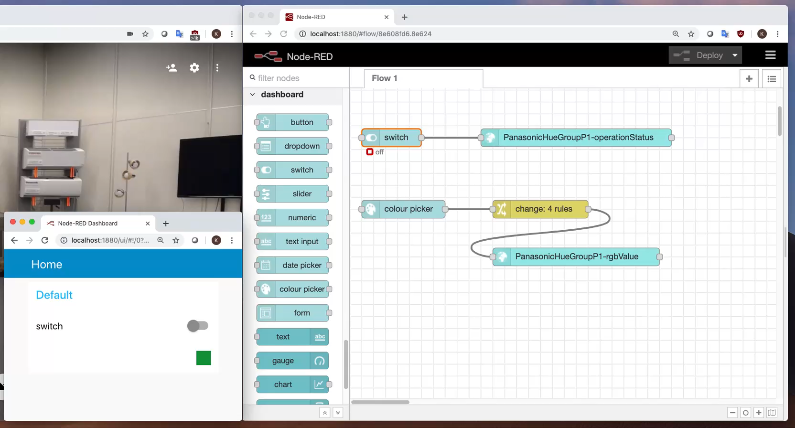
6. How to Use: Control the Thing using Dashboard

Slide 8
7. Resources
W3C Web of Things
Working Group Page: https://www.w3.org/WoT/WG/
Architecture: https://www.w3.org/TR/wot-architecture/
Thing Desciption: https://www.w3.org/TR/wot-thing-description/
Node-RED: https://nodered.org/
Node generator:
Document: https://github.com/node-red/node-red-nodegen/blob/master/docs/index.md
GitHub: https://github.com/node-red/node-red-nodegen
Npm: https://www.npmjs.com/package/node-red-nodegen

